Slide 1

Slide Set - 12
Organized & Presented By:
Software Engineering Team CSED
TIET, Patiala

Slide 2
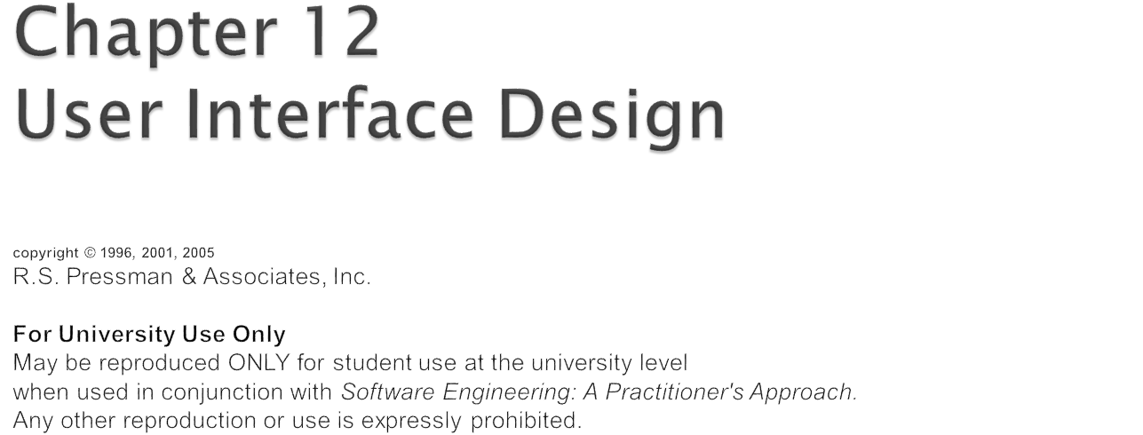

Slide 3

User interfaces should be designed to match the skills, experience and expectations of its anticipated users.
System users often judge a system by its
interface rather than its functionality.
A poorly designed interface can cause a user to make catastrophic errors.
Poor user interface design is the reason why so many software systems are never used.

Slide 4

Limited short-term memory
  People can instantaneously remember about 7 items of information. If you present more than this, they are more liable to make mistakes.
People make mistakes
  When people make mistakes and systems go wrong, inappropriate alarms and messages can increase stress and hence the likelihood of more mistakes.
People are different
  People have a wide range of physical capabilities. Designers should not just design for their own capabilities.
People have different interaction preferences
  Some like pictures, some like text.

Slide 5


Slide 6

A good user interface should be attractive:
  An attractive user interface catches user attention and fancy.
  In this respect,
    graphics-based user interfaces have a definite advantage over text-based interfaces.

Slide 7

Consistency of commands is very desirable.
  allow users to generalize the knowledge about one aspect of the interface to another.
Consistency helps in:
  speed of learning,
  speed of recall,
  also helps in reduction of error rate.

Slide 8

A good user interface must provide constant feedback to user actions:
  For example, if any user request takes more than few seconds to process,
    the user must be informed that his/her request is still being processed.
  If possible, the user should be periodically informed about the progress made in processing the command.

Slide 9
In the absence of any response from the computer for a long time:
  a novice user might even start recovery/shutdown procedures in panic.

Slide 10

Easy to learn?
Easy to use?
Easy to understand?

Slide 11

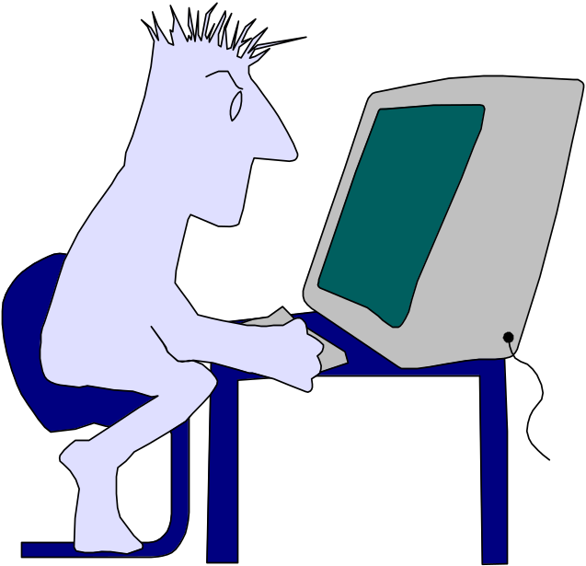
Typical Design Errors
lack of consistency
too much memorization
no guidance / help
no context sensitivity
poor response
Arcane/unfriendly

Slide 12

Place the user in control
Reduce the user’s memory load
Make the interface consistent

Slide 13

Define interaction modes in a way that does not force a user into unnecessary or undesired actions.
Provide for flexible interaction.
Allow user interaction to be interruptible and undoable.
Streamline interaction as skill levels advance and allow the interaction to be customized.
Hide technical internals from the casual user.
Design for direct interaction with objects that appear on the screen.

Slide 14
Reduce demand on short-term memory.
Establish meaningful defaults.
Define shortcuts that are intuitive.
The visual layout of the interface should be based on a real world metaphor.
Disclose information in a progressive fashion.

Slide 15
Allow the user to put the current task into a meaningful context.
Maintain consistency across a family of applications.
If past interactive models have created user expectations, do not make changes unless there is a compelling reason to do so.

Slide 16
User model — a profile of all end users of the system
Design model — a design realization of the user model
Mental model (system perception) — the user’s mental image of what the interface is
Implementation model — the interface “look and feel” coupled with supporting information that describe interface syntax and semantics

Slide 17
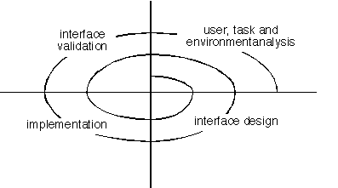

Slide 18

Interface analysis means understanding
  (1) the people (end-users) who will interact with the system through the interface;
  (2) the tasks that end-users must perform to do their work,
  (3) the content that is presented as part of the interface
  (4) the environment in which these tasks will be conducted.

Slide 19

Are users trained professionals, technician, clerical, or manufacturing workers?
What level of formal education does the average user have?
Are the users capable of learning from written materials or have they expressed a desire for classroom training?
Are users expert typists or keyboard phobic?
What is the age range of the user community?
Will the users be represented predominately by one gender?
How are users compensated for the work they perform?
Do users work normal office hours or do they work until the job is done?
Is the software to be an integral part of the work users do or will it be used only occasionally?
What is the primary spoken language among users?
What are the consequences if a user makes a mistake using the system?
Are users experts in the subject matter that is addressed by the system?
Do users want to know about the technology the sits behind the interface?

Slide 20

Answers the following questions …
  What work will the user perform in specific circumstances?
  What tasks and subtasks will be performed as the user does the work?
  What specific problem domain objects will the user manipulate as work is performed?
  What is the sequence of work tasks—the workflow?
  What is the hierarchy of tasks?
Use-cases define basic interaction
Task elaboration refines interactive tasks
Object elaboration identifies interface objects (classes)
Workflow analysis defines how a work process is completed when several people (and roles) are involved

Slide 21

Response time
Help facilities
Error handling
Menu and command labeling
Application accessibility

Slide 22

